Slide 1
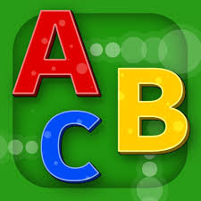
SMART ABC LEARNING SYSTEM
Project Members:
ANMOL DHAWAN – 101610010
ANKIT SINHA - 101783048
ANKUR SHARMA – 101603043
ANKUSH KARARA - 101603044
Mentor name – Dr. Anjali Anand
CPG No. - 12

Slide 2
PROBLEM DEFINITION
We want to increase the technological use in the learning process of a child. So, we want to take the concept of interactive learning at higher level and involve it in the fundamental process of learning.
The traditional method of learning is not so much fascinating and interactive and it is very time consuming.
Learning combined with fun and interaction will decrease the learning time by using computer vision methods.

Slide 3
PROJECT SCOPE
Our project mainly evolves around the effective learning of fundamentals (English alphabets, digits etc.) writing for children in a smart way using finger gestures (by moving finger in air).
This is futuristic way of learning which would help children to inculcate the habit of interactive learning.

Slide 4
OBJECTIVES
The sensor that is camera should be configured properly with the object held by user.
The delay between the object motion and tracking on screen should be minimum.
The letter/digit tracked by user should be displayed on screen correctly.
Corresponding output in form of audio and images will be displayed after recognition.

Slide 5
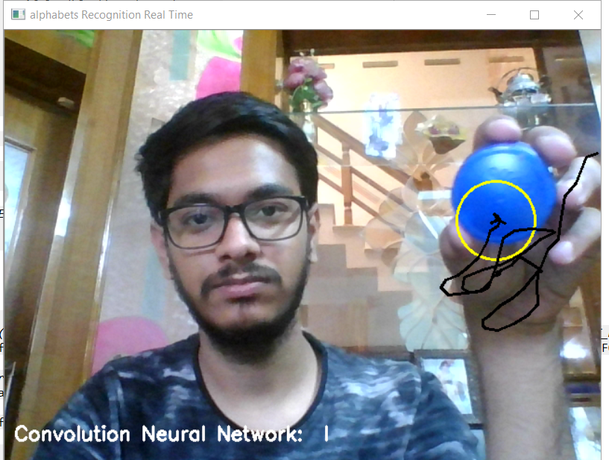
PROJECT ANALYSIS AND DESIGN
This project mainly uses the following uses the following concepts:
Object detection and tracking: Object tracking based techniques is the most popular choice to detect stationary foreground objects because they work reasonably well when the camera is stationary and the change in ambient lighting is gradual, and they also represent the most popular choice to separate foreground objects from the current frame.

Slide 6
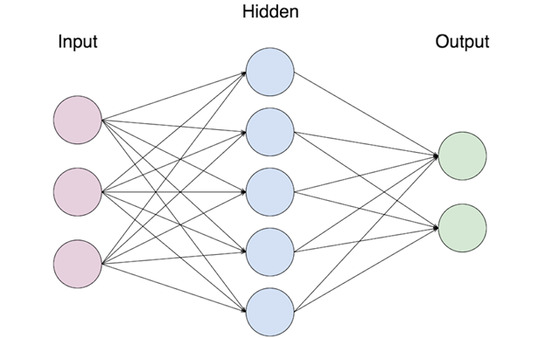
CONTD..
Image Processing: It is used to filter out the noises in the frame from the webcam and extract information from the frame regarding object.
Deep Learning: Optical Character Recognition (OCR) and Handwritten Character Recognition (HCR) has specific domain to apply. Various techniques have been proposed to for character recognition in handwriting recognition system.

Slide 7
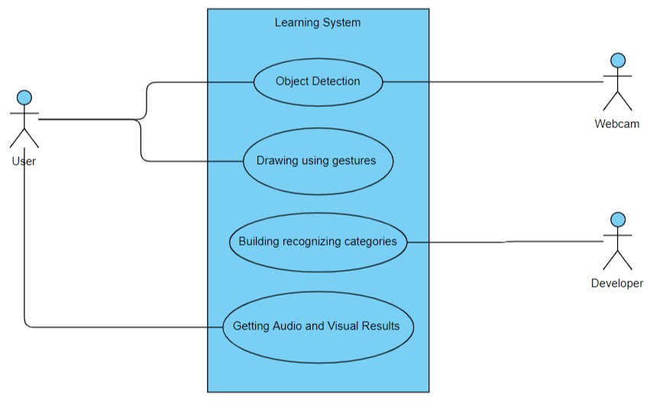
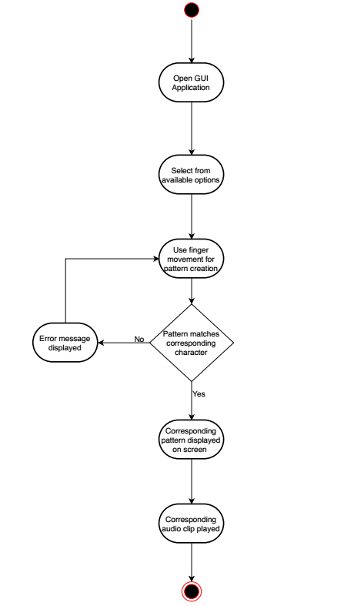
UML DIAGRAMS
USE CASE DIAGRAM:
ACTIVITY DIAGRAM:

Slide 8
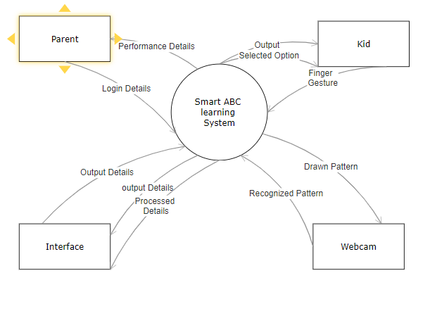
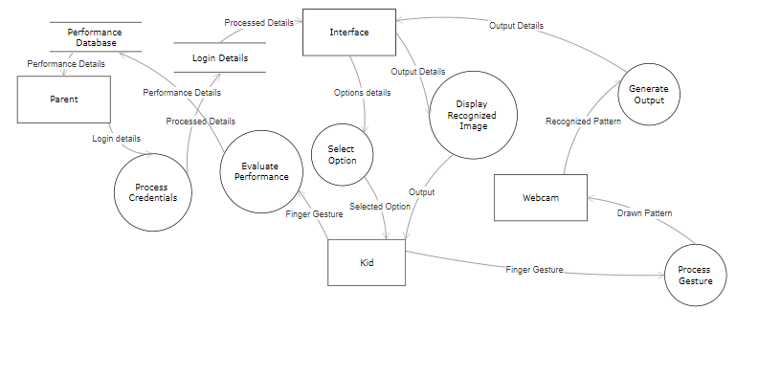
DETAILED DESIGN
DATA DESIGN
DFD level 0
DFD level 1

Slide 9
TOOLS AND TECHNOLOGY USED
Open CV library :- We are using 4.0.1 version of CV library. It is generally used for combining vision task.
CNN using Keras :- CNN is using for alphabet recognition.
Image Processing :- Frame is read and processed using image processing technique.
Python :- We use Python language as it has good collection of image processing libraries also it is used in open CV .

Slide 10
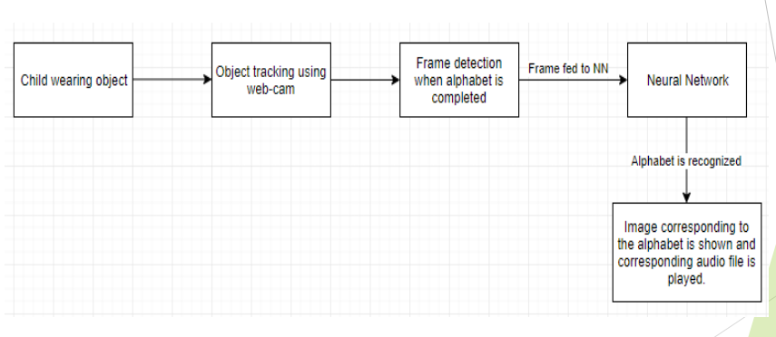
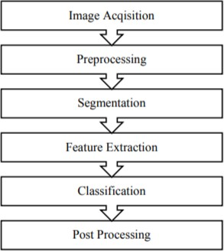
ARCHITECTURE
BLOCK DIAGRAM
WORKING STEPS

Slide 11
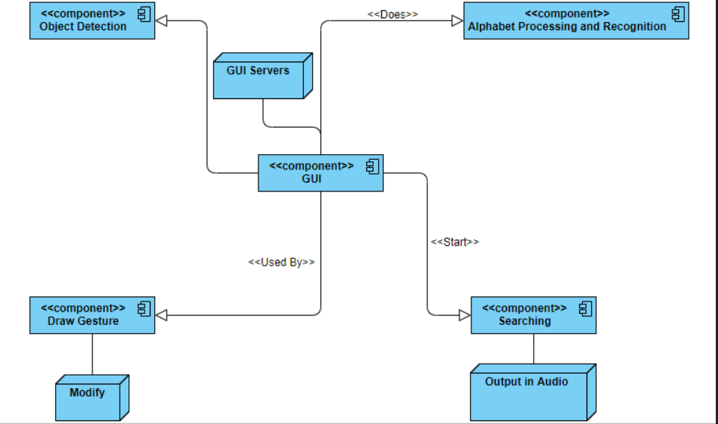
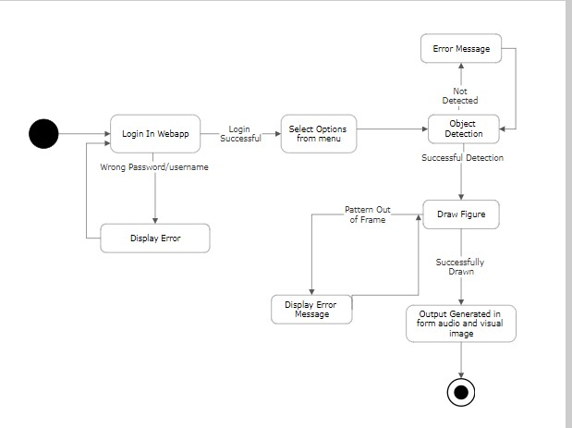
COMPONENT AND USER INTERFACE DESIGN
COMPONENT DIAGRAM
USER INTERFACE DESIGN

Slide 12
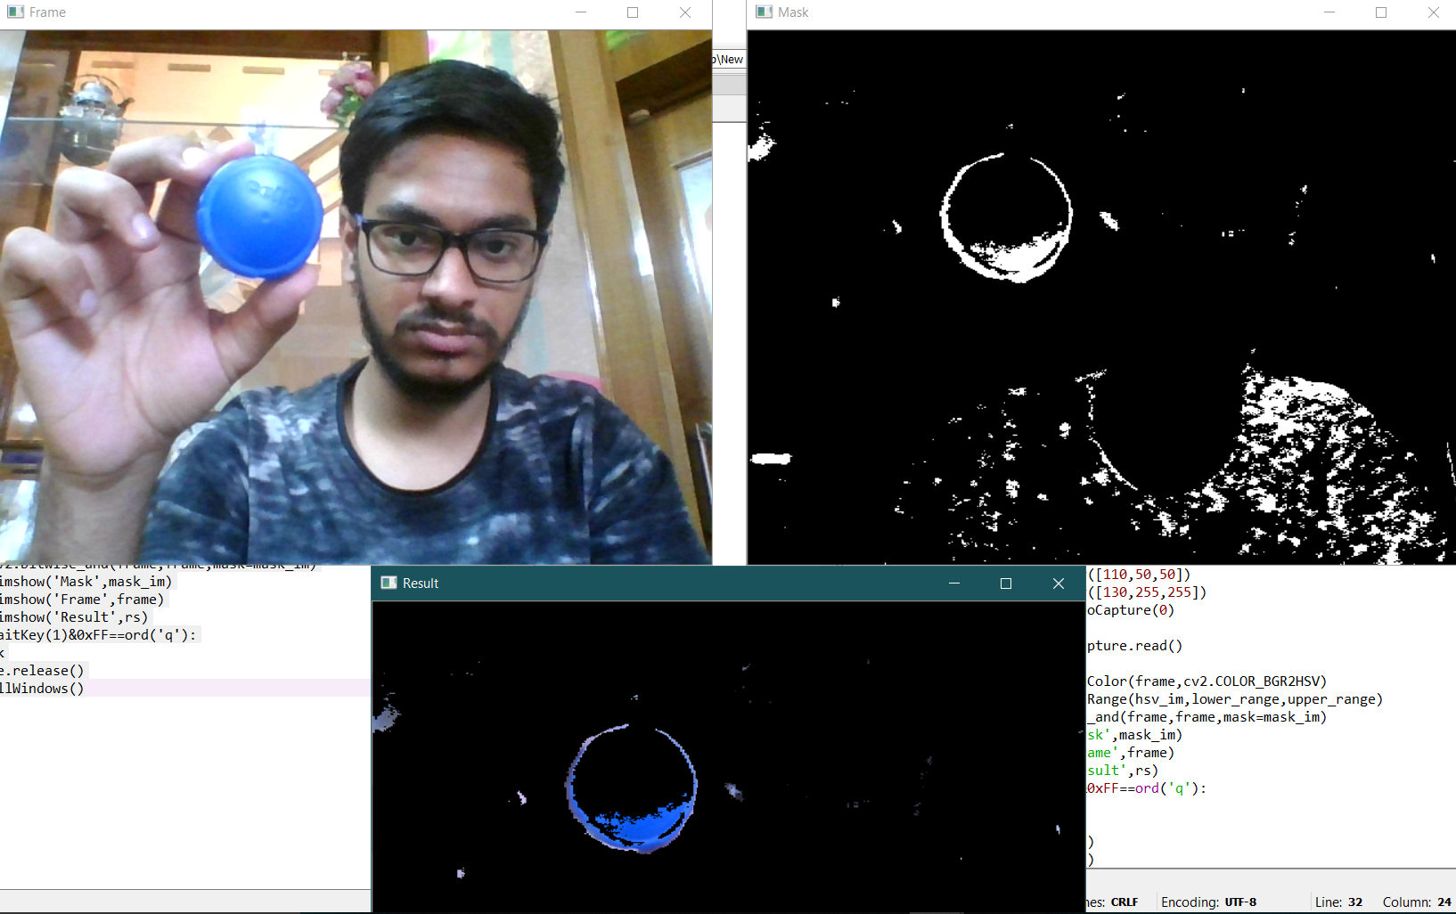
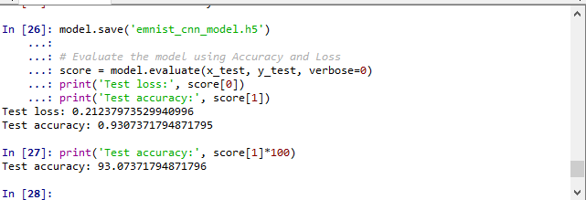
PROJECT OUTCOMES
PRODUCT - A web application which will act as a platform for the kids to enhance their fundamentals (alphabets) by drawing on screen by moving finger in air.
WORKING PROTOTYPE -

Slide 13
ROLE/CONTRIBUTIONS OF TEAM MEMBERS
Anmol Dhawan: Implementation and optimization of opencv’s object detection and tracking algorithm, Image processing and to build the system for realizing drawing by moving fingers in air.
Ankit Sinha: Selection, optimization, training and testing of Deep Learning models to recognize alphabet/digit correctly.
Ankur Sharma: Web app designing, interfacing frontend and backend and maintaining user base of our website.
Ankush Karara: Web app designing and making the website interactive by designing questions for the user.

Slide 14
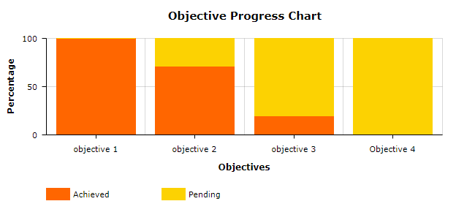
CURRENT PROGRESS
The following objectives have been achieved successfully:
The sensor that is camera should be configured properly with the object held by user.
The delay between the object motion and tracking on screen should be minimum.

Slide 15
Future work plan
Experimentation:
We will be going to do experimentation with object being used to draw alphabets.
We will get the optimized size and shape of it.
We are thinking to design a digital pen which can be used for making patterns(air gestures).
Displaying output:
We are going to work for displaying the output in form of audio and pictures after being successfully recognized.
User Interface:
User interface will be designed with the help of Python and web development.

Slide 16
Thank You!!

